Slide 1

Ad-blocking: A Study on Performance, Privacy and Counter-measures
Kiran Garimella, Orestis Kostakis and Michael Mathioudakis

Slide 2
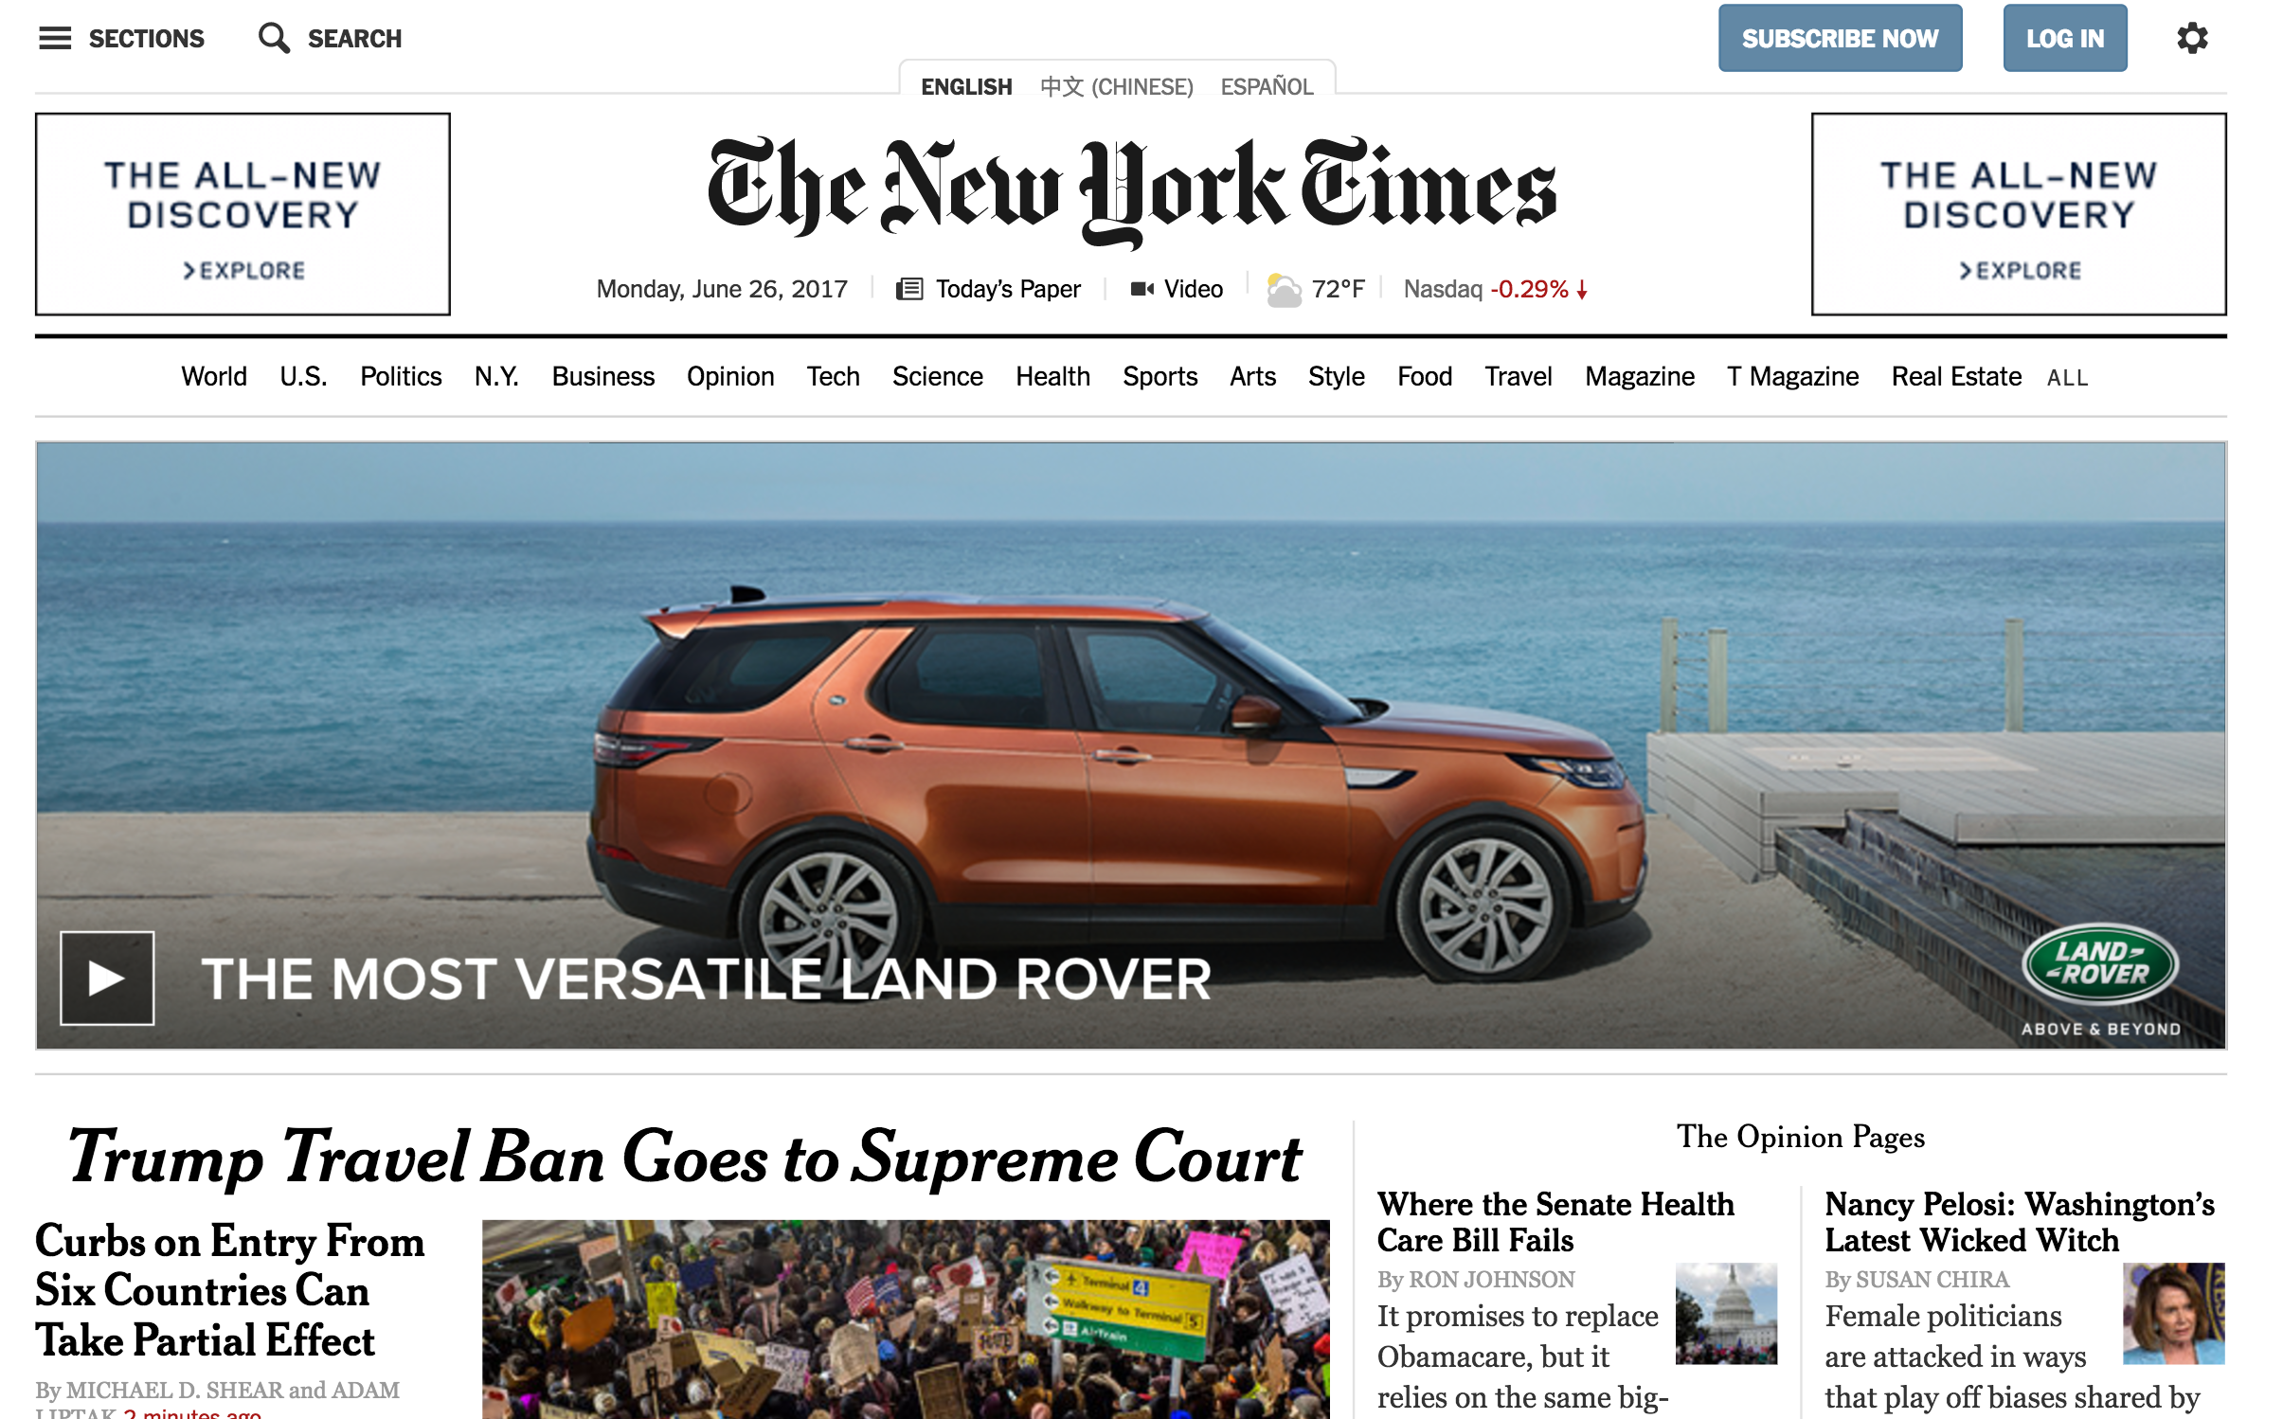
Motivation
Ads everywhere!

Slide 3
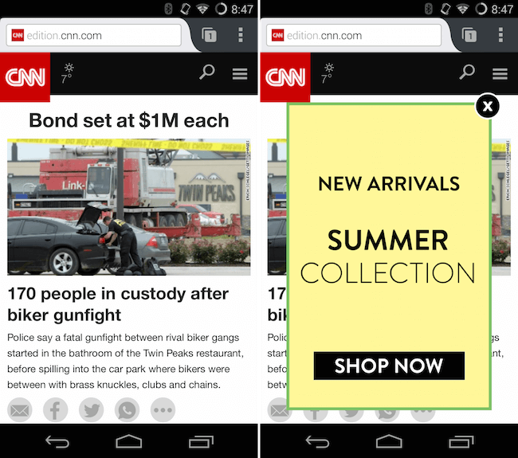
It's worse on mobile

Slide 4
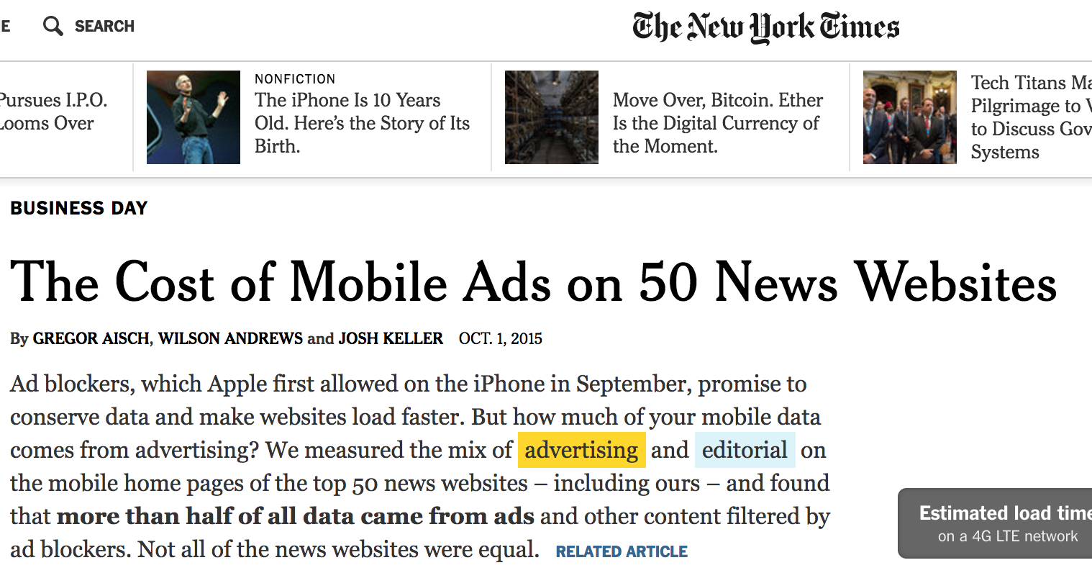
Over 50% traffic from ads!!!

Slide 5
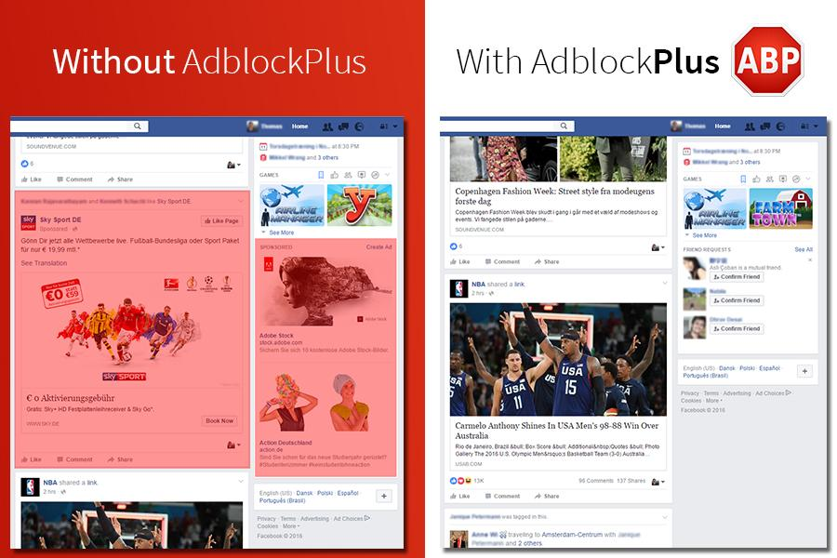
Solution: Ad-blocking

Slide 6
This paper
Quantify adblocking usage on a large scale

Slide 7
Data
5 most popular adblockers
Adblock, Adblock Plus, UBlock, Ghostery and Privacy Badger
30,000 news pages
From a day in GDELT
Notes:
Data availabe https://users.ics.aalto.fi/kiran/adblock/

Slide 8
Data
Simulate browser page load with Selenium
6 modes - one with out ad block + 5 with the different adblockers
Collect stats
Load time
Data transferred
All Network requests
Types of objects loaded
Data available at https://users.ics.aalto.fi/kiran/adblock/
Notes:
Data availabe https://users.ics.aalto.fi/kiran/adblock/

Slide 9
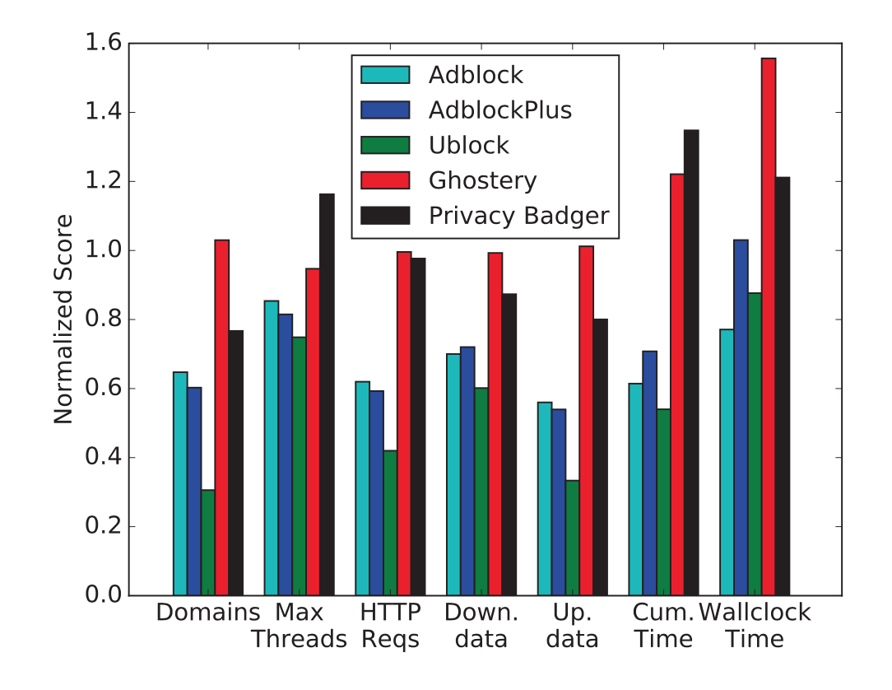
Findings
Performance

Slide 10
Blocking adblockers

Slide 11
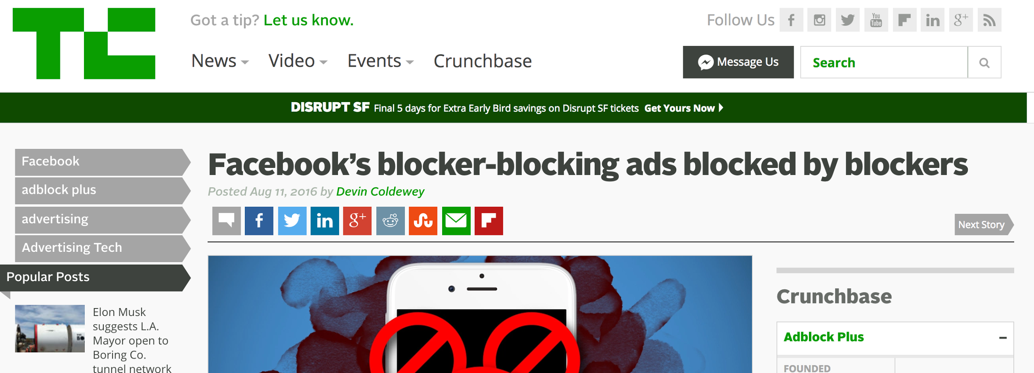
Blocking adblockers

Slide 12

Blocking adblockers

Slide 13
Blocking adblockers
Adblock blockers are prevalent!
~11% of the webpages explicitly use anti adblocking tools
Much higher for Adblock and AdBlockPlus (33%)

Slide 14
Requests made by adblockers
Vanilla mode - V
Adblock mode - A
V \ A -> Ads
A \ V -> artifacts introduced from using an adblocker
Requests by adblockers
Finding:
Adblockers block tracking from Google analytics
But .. install their own tracking
Except UBlock

Slide 15
Conclusions
Adblockers might not be helping (in terms of privacy/data)
Adblockers have their own overhead
Adblock blockers are growing!
Ublock is the best
Things are fast evolving

Slide 16
Thank you!
@gvrkiran
Data available at https://users.ics.aalto.fi/kiran/adblock

